Slide 1

Invasive Plant Species in Urban Forest Areas
Lissandro Alvarado, Harrison Halesworth, Tegan Kelsall
Mentor: Kelly McConville
Stakeholders: USDA FIA Team (Andy Lister, Tonya Lister, Alex Young)
Notes:
All

Slide 2
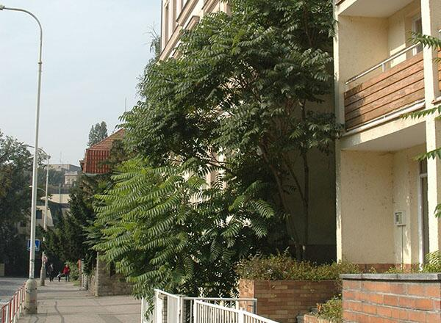
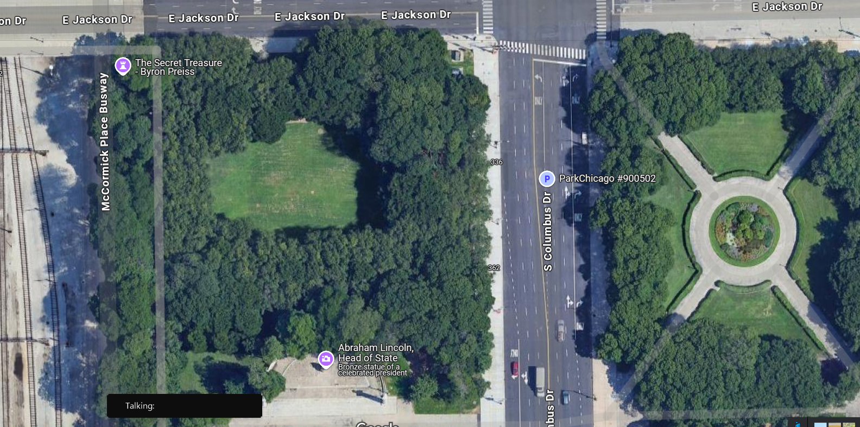
Project Motivation
Better understand the relationship between native and invasive species in “Urban Forest” areas
Find the optimal machine learning model for predicting invasive species
Notes:
Tegan
An urban forest is a collection of trees and other vegetation in urban areas. Urban forests can include trees in parks, along streets, and in residential properties

Slide 3





Our Collaborators
USDA
Forest Service
National Forest System
State and Private
Research
Forest Inventory and Analysis (FIA)
Urban Forest Inventory and Analysis (UFIA)
Notes:
Tegan
Explain IPS but be specific about which we are focusing on
Explain UFIA vs. FIA
Why UFIA’s work is important
How/where UFIA is collecting data
Data visualizations!!!
Urban FIA collects data on plants in a city, and assesses their quantity, health, and species composition, to understand the benefits and potential risks of the urban forest. It essentially provides a detailed picture of the urban tree canopy to help policy decisions

Slide 4

Wrangling
Many weeks of transformation with the data
Changed continuous variable to binary
Weighted Tree/Shrub Coverage
Finding proportion of IPS is challenging, better to predict presence/absence instead
Filtered down to top 5 IPS
Notes:
lissandro
Explain plot and condition level data, why it was an issue
Explain our solution (weighted averages, aggregating features to plot level from condition level)
Include the graphic from Andy’s presentation
Maybe show data transformation?
Explain importance of switching IPS presence/absence target variable to binary indicator variable

Slide 5
Research Goal: Predict Presence of Invasive Species
Predictor Variables (Model 1):
Weighted tree cover
Weighted shrub cover
Latitude
Longitude
Public vs. Private
Maintained vs. Unkept
FIA Landuse
Invasive Species of interest:
Honeysuckle
Multiflora Rose
Norway Maple
Siberian Elm
Tree of Heaven
Predictor Variables (Model 2):
Including city
Notes:
Add FIA_Landuse back in after Monday
lissandro

Slide 6
Models
Notes:
Highlights!
First explain differences between three modeling types
Choose ONE IPS to be consistent throughout presentation
Strengths and weaknesses of each

Slide 7
Why Logistic Regression?
Logistic regression models are less complex than other machine learning (ML) methods, making them easier to implement.
Easy to interpret relationship between variables and predictive
Notes:
Lissandro
Highlights!
First explain differences between three modeling types
Choose ONE IPS to be consistent throughout presentation

Slide 8
Model Results: Logistic Regression WITH CITY
Variable | Odds
(Intercept) | 2.70E+116
LAT | 1.40E-05
LON | 1.07E-01
Chicago | 1.41E-19
Madison | 3.66E-04
Milwaukee | 1.96E-15
Minneapol | 7.76E+10
Portland | 1.00E+28
Providence | 1.92E+15
Public | 4.45E-05
Minneapolis was the city with the highest Odds
Being in Minneapolis the odds of multiflora are 7.76 times higher
Notes:
Lissandro
Highlights!
First explain differences between three modeling types
Choose ONE IPS to be consistent throughout presentation

Slide 9
Model Results: Logistic Regression WITH CITY
term | Odds
weighted_tree_cover | 1.19E+05
weighted_shrub_cover | 9.69E+00
Maintained area | 5.25E-01
FIA_LANDUSECommercial | 2.26E-02
FIA_LANDUSEForest Land | 2.21E+02
FIA_LANDUSERecreational | 3.66E+11
FIA_LANDUSEResidential | 6.53E-02
FIA_LANDUSETransportation | 3.11E-11
Weighted Shrub coverage was the strongest predictor
For every 1-unit increase in the weighted shrub cover, the odds of multiflora presence are 9.69 times higher, holding all other variables constant.
Notes:
Lissandro
Highlights!
First explain differences between three modeling types
Choose ONE IPS to be consistent throughout presentation

Slide 10
Model Results: Logistic Regression WITHOUT CITY
Term | Estimate
(Intercept) | 4.29E-01
LAT | 8.96E-01
LON | 1.17E+00
Pub_PrivPrivate | 1.17E+07
Pub_PrivPublic | 8.17E+05
weighted_tree_cover | 7.48E+01
weighted_shrub_cover | 1.71E+00
IS_MAINTAINED_AREA | 3.75E-01
FIA_LANDUSECommercial | 4.89E-01
FIA_LANDUSEForest Land | 1.91E+00
FIA_LANDUSERecreational | 6.35E+00
FIA_LANDUSEResidential | 4.44E-01
FIA_LANDUSETransportation | 2.10E+00

Slide 11
Model Results Test Data: Logistic Regression
Accuracy | 89.42%
Sensitivity True Positive | 58%
Specificity True Negative | 95%
Notes:
Lissandro
Highlights!
First explain differences between three modeling types
Choose ONE IPS to be consistent throughout presentation

Slide 12
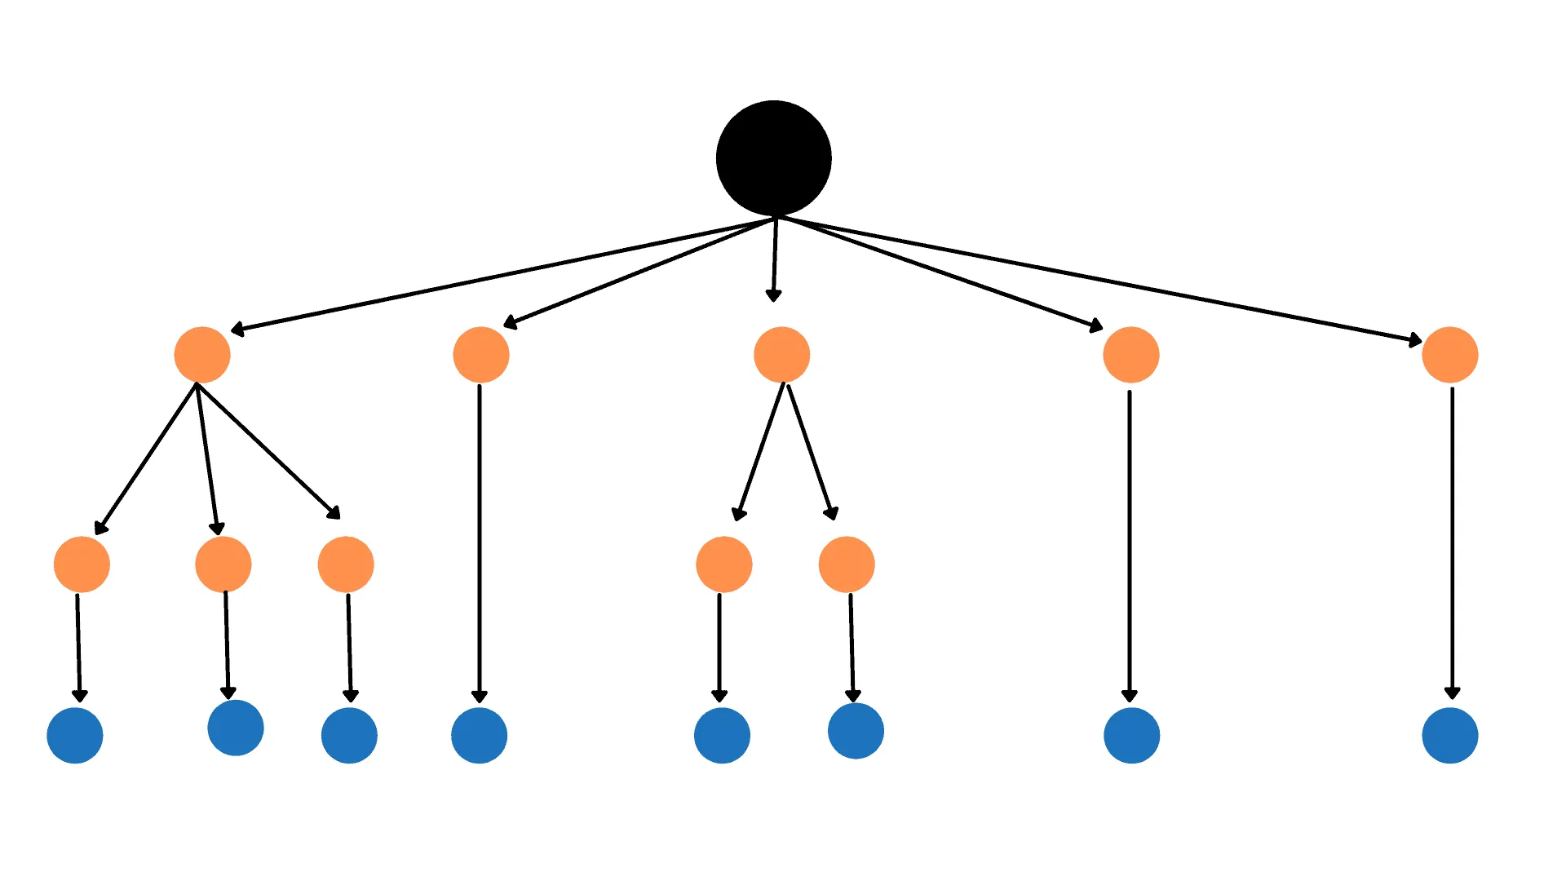
Why Classification Trees
Easy to visualize
Very expressive
Works on discrete data
Notes:
Lissandro
Highlights!
First explain differences between three modeling types
Choose ONE IPS to be consistent throughout presentation

Slide 13
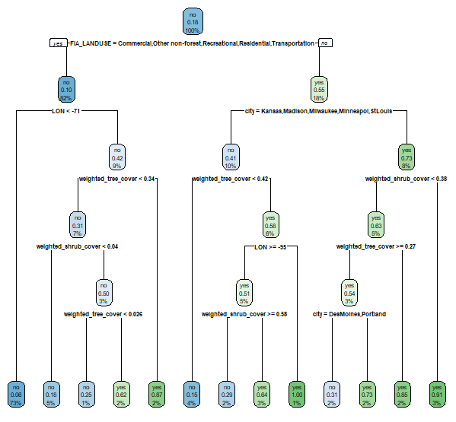
Model Results:
Classification
Tree
Multiflora Rose
with city
Notes:
Tegan
Highlights!
First explain differences between three modeling types
Choose ONE IPS to be consistent throughout presentation
Better in predicting presence rather than absence

Slide 14
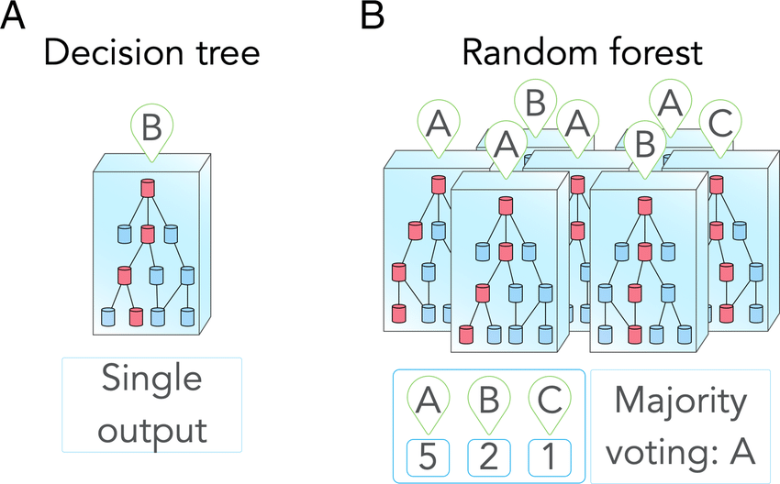
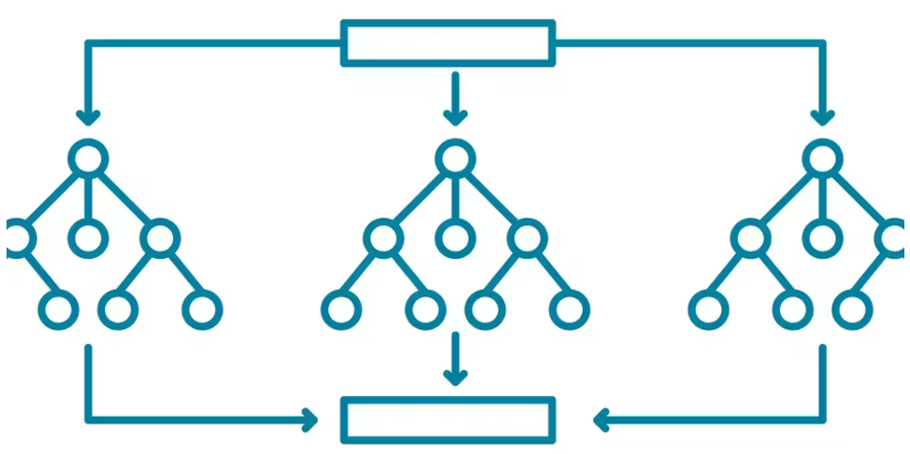
Random Forest (RF)
Ensemble method - robust
Choices made from the decisions of multiple classification trees
Avoids overfitting!
Generally more accurate
Easy to interpret variable importance
Deals well with class imbalance
Notes:
Harrison

Slide 15
Considerations
Prone to overfitting when using default classifier
Received 100% accuracy on training data for most models
Can adjust max depth, min samples to split on, and min samples at leaf for individual trees in the forest as well as things like the number of trees to remedy this
High importance of categorical variables can sometimes be attributed to the cardinality of that variable
Correlated variables can split their importance
Notes:
Harrison

Slide 16
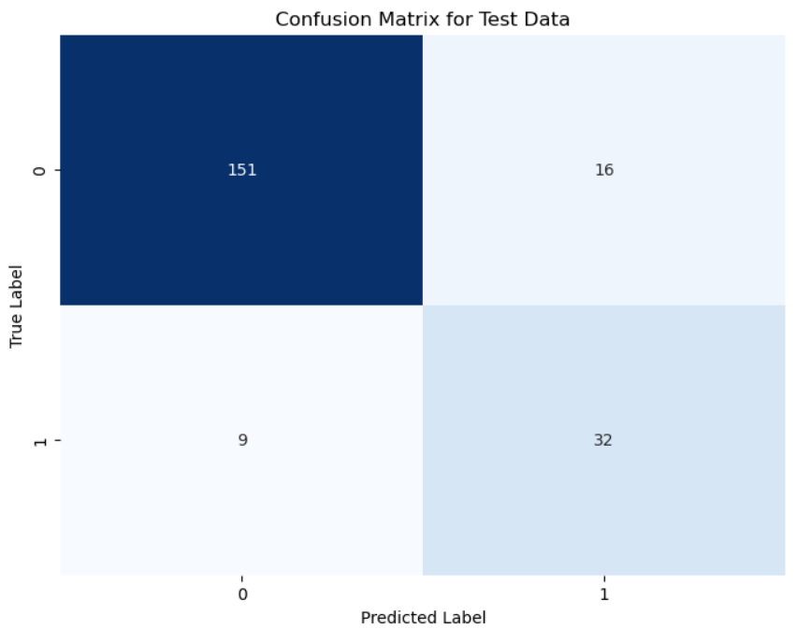
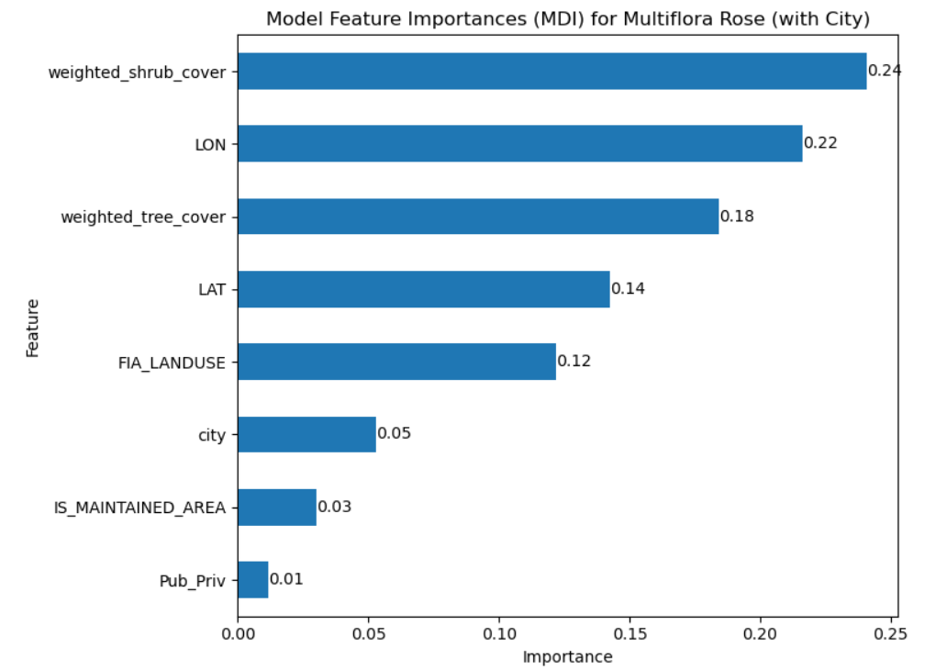
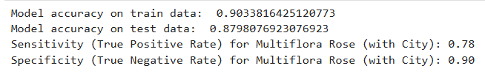
Example Results: Multiflora Rose
TP
FN
FP
TN
Notes:
Harrison

Slide 17
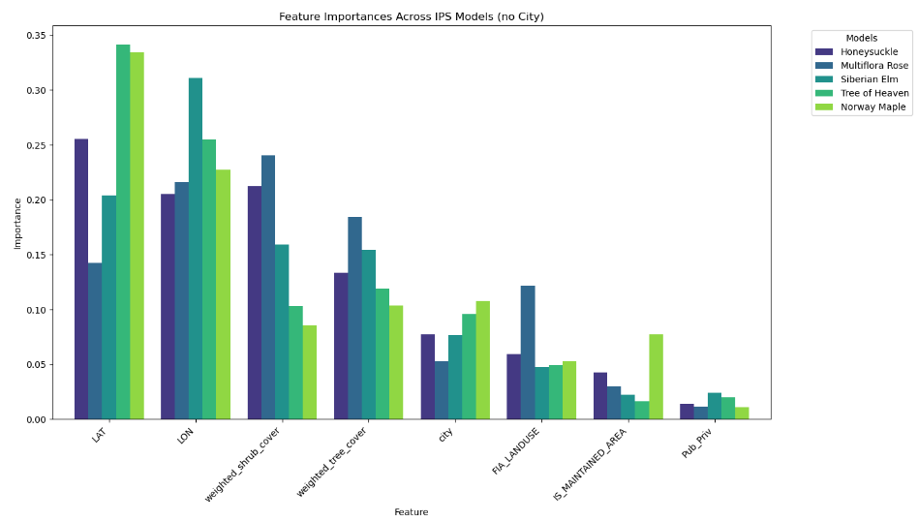
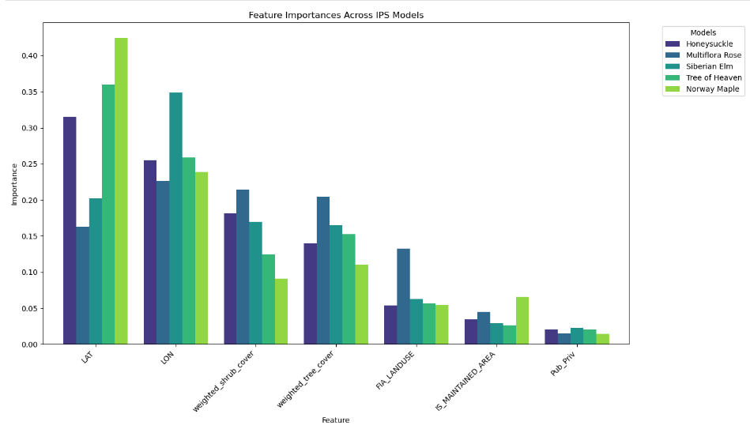
Feature Importances
Latitude and longitude are consistently the most important.
Weighted tree and shrub cover are moderately important.
FIA Landuse is nearly three times as important in predicting Multiflora Rose than the remaining species.
Maintained vs. unkept and public vs. private had minimal importance, which surprised me.
Notes:
Harrison

Slide 18
Performance
Notes:
Highlights!
First explain differences between three modeling types
Choose ONE IPS to be consistent throughout presentation
Strengths and weaknesses of each

Slide 19
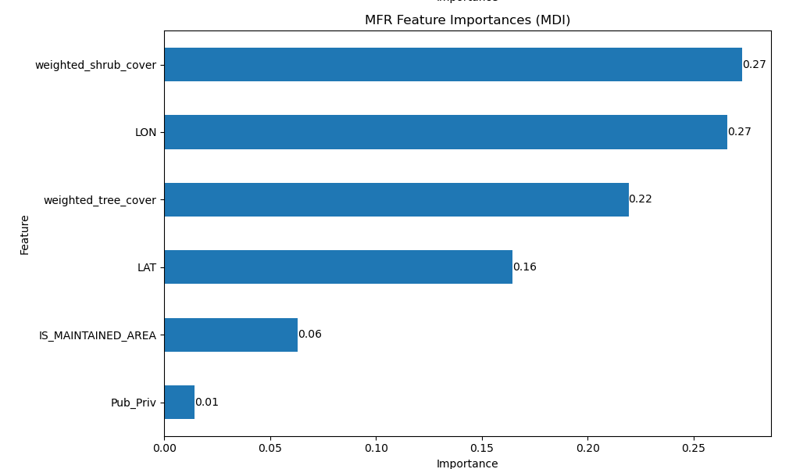

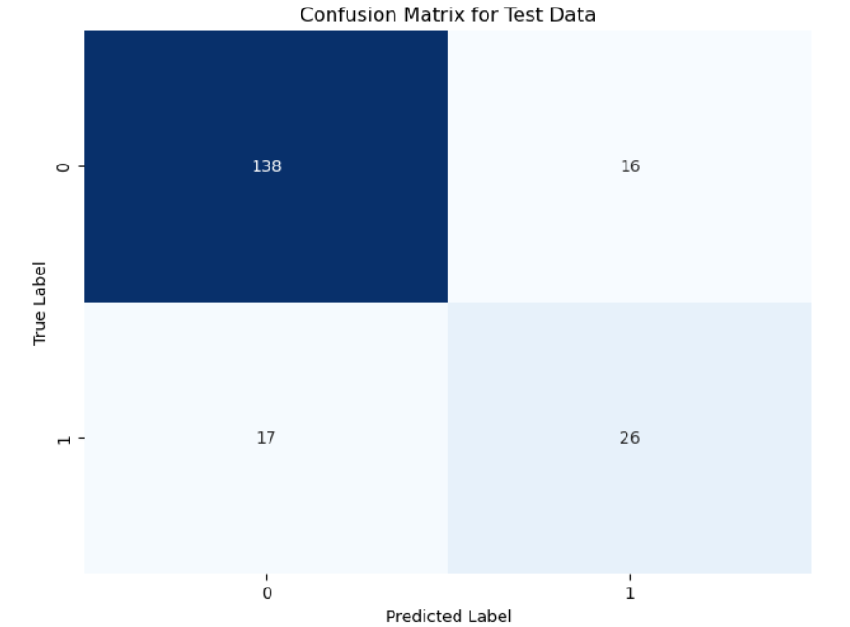
RF Results
TP
FP
Weighted shrub cover and longitude are the most important variables via MDI (Mean Difference in Impurity) closely followed by weighted tree cover
The model did a good job predicting absence but not presence
TN
FN
Notes:
Harrison
Highlights!
First explain differences between three modeling types
Choose ONE IPS to be consistent throughout presentation

Slide 20
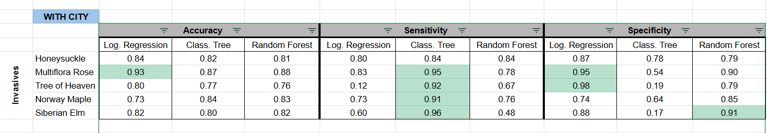
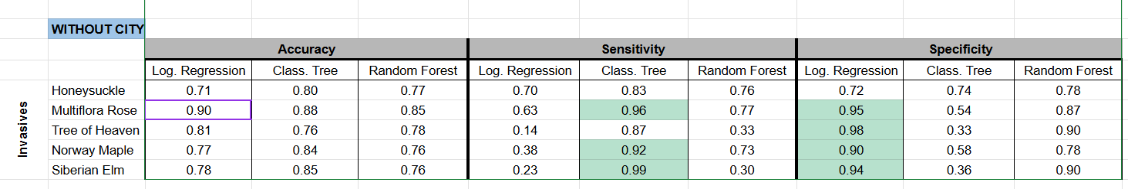
With and Without City
Sensitivity: True Positive Rate
Specificity: True Negative Rate
Notes:
tegan

Slide 21
Analysis/Takeaways
Average accuracy across all ips with and without city
Logistic Regression: 0.81
Classification Tree: 0.82
Random Forest: 0.80
Based on accuracy our best modeling technique was classification trees
Our classification tree models also performed well in terms of its sensitivity (true positive rate) while our logistic regression models performed best in terms of its specificity (true negative rate)
Notes:
Harrison
What can we say about certain features’ influence on IPS presence?
Try to explain at a high level, for instance don’t just say priv_pub was important, explain why it would make sense for public land to more heavily feature IPS due to less maintenance

Slide 22
Future Iterations/Next Steps
Implement models to include more invasive species and more cities/urban forest areas
Investigate relationships between weighted shrub cover and weighted tree cover
Expand our UFIA analysis techniques to general FIA data
Include more variables gathered from urban forests
Consider including city as a random effect in the models.
Notes:
Harrison
What would we do next if we were to continue this project?
Can we apply similar tactics to regular FIA data and get same benefit?
How confident can we be in our findings thus far? What can we do to reinforce and confirm our findings so that they can be used in decision making for cities and public agencies?

Slide 23
Questions?

Slide 24
Conclusion
Regression trees was the most accurate
Notes:
Across 5 species, across all models
Table of prediction accuracy, specificity, sensitivity
Which IPS can we predict the best, which model was best at predicting which
Interpretation of a cell in context (pick cell and explain in layman terms)
Return to research questions, explain findings

Slide 25
Notes
2 min on motivation
5 min on data viz
Rest of time on modeling
Lissandro=>Tegan=>Harrison
Make sure presentation is understandable and at a high level

